Slide 1


ROLLING ELLIPSE (2D) PROJECT
Group 23
Members:
1.) Prakash Mallick
2.) Panthep Tharanon
3.) Mark Robinson
4.) Ashis Mohapatra
ADVANCE DYNAMIC

Slide 2
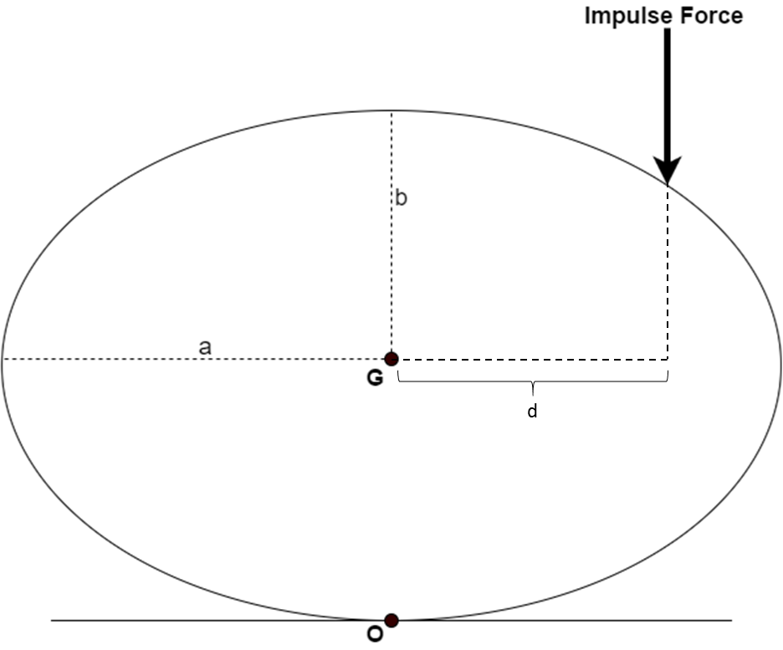
PROBLEM STATEMENT
“An ellipse having mass m, is lying motionless on a horizontal surface. A impulse force suddenly exerts on it and the ellipse starts to roll without slipping”
ADVANCE DYNAMIC

Slide 3
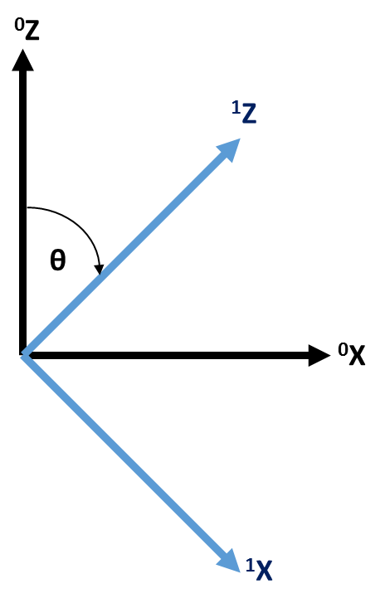
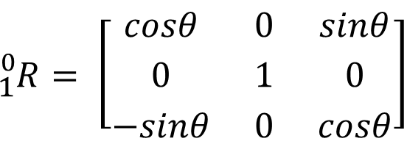
COORDINATES SYSTEM
ROTATION MATRIX
¹Z
¹X
⁰Z
$${}_{1}^{0}{R= \left[\begin{matrix}cosθ & 0 & sinθ \\ 0 & 1 & 0 \\ −sinθ & 0 & cosθ\end{matrix}\right]}$$
⁰X
ADVANCE DYNAMIC

Slide 4
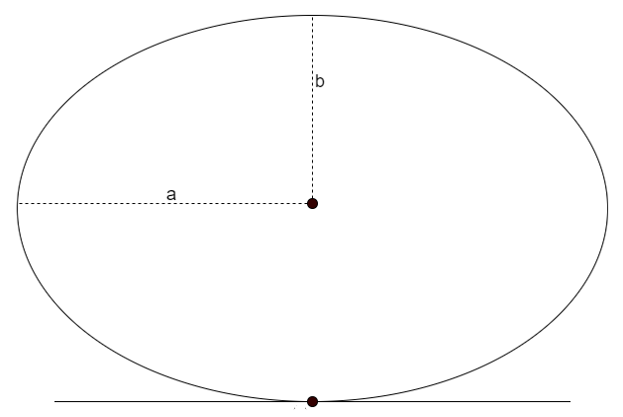
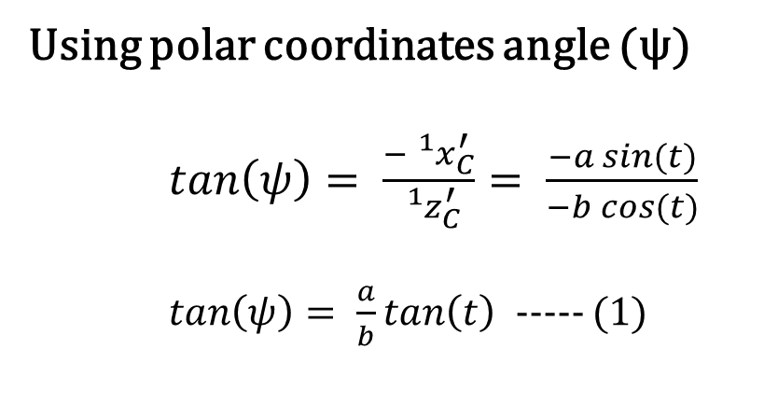
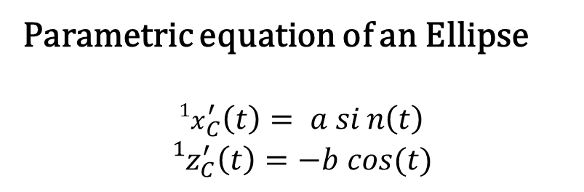
SYSTEM GEOMETRY
If we focus only on the ellipse
¹Z
Parametric equation of an Ellipse
$${{}_{}^{1}x}_{C}^{′}\left(t\right)= a sin\left(t\right)$$
$${{}_{}^{1}z}_{C}^{′}\left(t\right)=−b cos⁡(t)$$
Point G is the center of gravity of the ellipse which position can be obtained from (x,z)
G
¹X
Using polar coordinates angle (ψ)
$tan\left(ψ\right)= \frac{−{{}_{}^{1}x}_{C}^{′}}{{{}_{}^{1}z}_{C}^{′}}= \frac{−a sin(t)}{−b cos(t)}$
$tan\left(ψ\right)= \frac{a}{b}tan\left(t\right)⁡$ ----- (1)
G
ψ
r
Point C is the point of contact between the ground and the ellipse
C
C
ADVANCE DYNAMIC

Slide 5
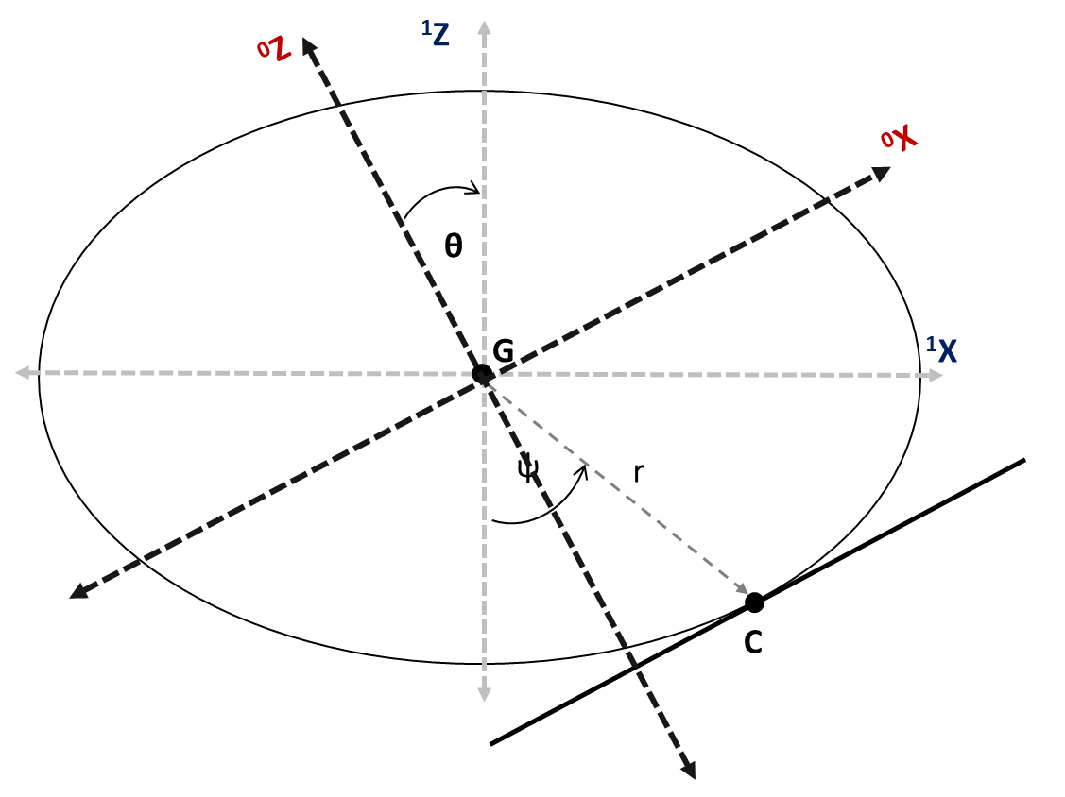
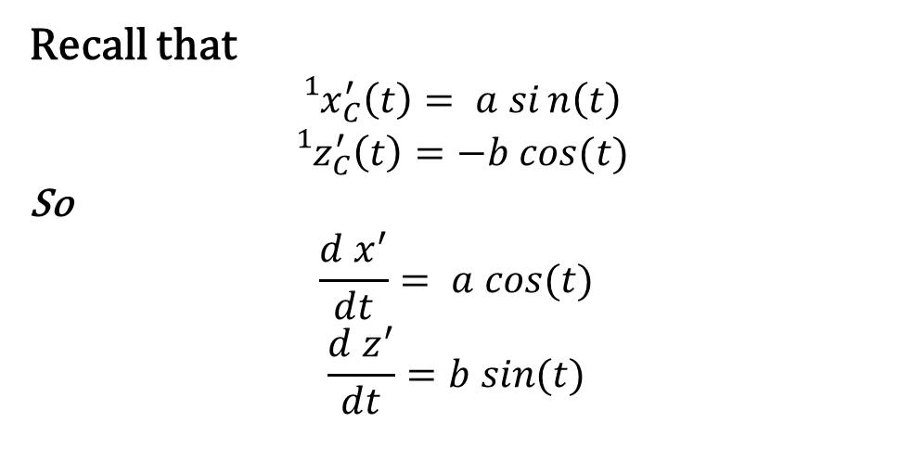
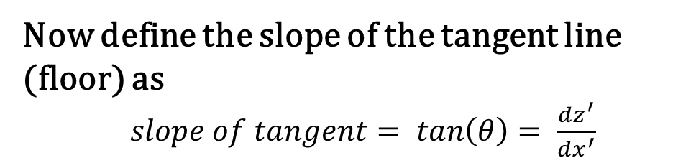
SYSTEM GEOMETRY
Now let’s focus on the floor
Also remember that this is equivalent to
⁰Z
¹Z
Now define the slope of the tangent line (floor) as
$slope of tangent= tan\left(θ\right)= \frac{dz^{′}}{dx^{′}}$
θ
G
¹X
⁰X
Recall that
$${{}_{}^{1}x}_{C}^{′}\left(t\right)= a sin\left(t\right)$$
$${{}_{}^{1}z}_{C}^{′}\left(t\right)=−b cos⁡(t)$$
So
$$\frac{d x^{′}}{dt}= a cos⁡(t)$$
$$\frac{d z^{′}}{dt}=b sin⁡(t)$$
ψ
r
C
θ
ADVANCE DYNAMIC

Slide 6
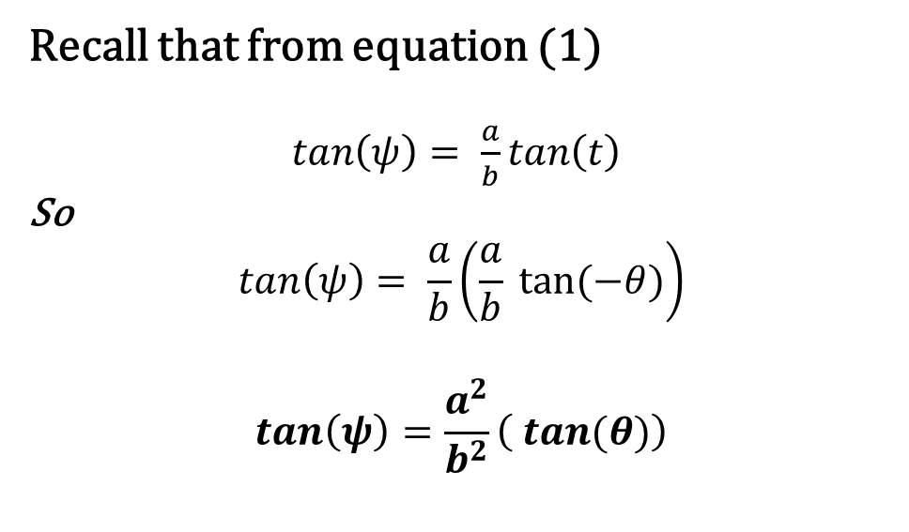

SYSTEM GEOMETRY
Now let’s focus on the floor
Also remember that this is equivalent to
⁰Z
¹Z
So the slope can be defined as
$$tan\left(θ\right)= \frac{dz^{′}}{dx^{′}}= \frac{b}{a} tan(t)$$
θ
Recall that from equation (1)
$tan\left(ψ\right)= \frac{a}{b}tan\left(t\right)⁡$
So
$$tan\left(ψ\right)= \frac{a}{b}\left(\frac{a}{b} tan⁡(−θ)\right)$$
$$tan\left(ψ\right)=\frac{a^{2}}{b^{2}}\left( tan⁡(θ)\right)$$
G
¹X
⁰X
ψ
r
C
θ
ADVANCE DYNAMIC

Slide 7
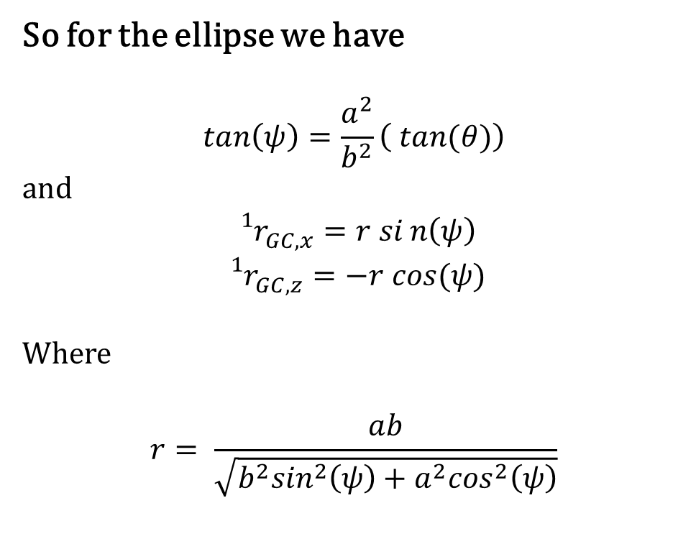
SYSTEM GEOMETRY
Now let’s focus on the floor
Also remember that this is equivalent to
⁰Z
¹Z
So for the ellipse we have
$$tan\left(ψ\right)=\frac{a^{2}}{b^{2}}\left( tan⁡(θ)\right)$$
and
$${{}_{}^{1}r}_{GC,x}^{}=r sin\left(ψ\right)$$
$${{}_{}^{1}r}_{GC,z}^{}=−r cos⁡(ψ)$$
Where
$$r= \frac{ab}{\sqrt{b^{2}\sin^{2}\left(ψ\right)+a^{2}\cos^{2}\left(ψ\right)}}$$
θ
G
¹X
⁰X
ψ
r
C
θ
ADVANCE DYNAMIC

Slide 8
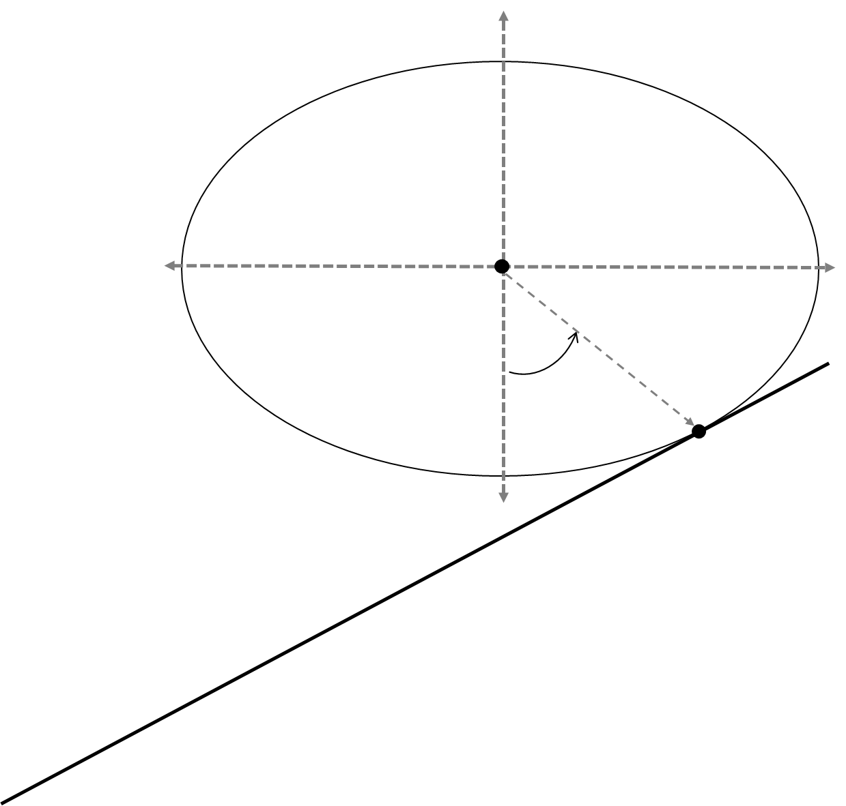
CONSTRAINT EQUATIONS
Define the generalized coordinates
¹Z
The generalized coordinates used to describe the motion of the ellipse are:
Q = {x, z, r, θ, ψ)
Since this is a 1 DOF system, there will be 4 constraint equations
G (x , z)
ψ
r
r_{GC}
¹X
O
C
ADVANCE DYNAMIC

Slide 9
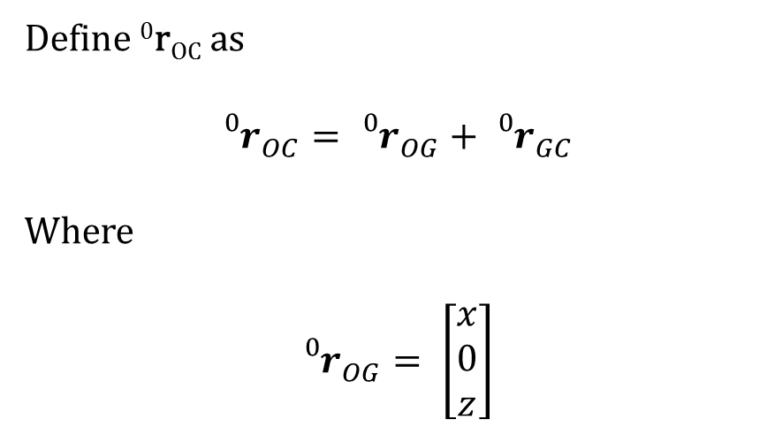
CONSTRAINT EQUATIONS
Constraint equations (from no-slip)
¹Z
Define ⁰r_{OC} as
$${{}_{}^{0}r}_{OC}^{}={{}_{}^{0}r}_{OG}^{}+{{}_{}^{0}r}_{GC}^{}$$
Where
$${{}_{}^{0}r}_{OG}^{}= \left[\begin{matrix}x \\ 0 \\ z\end{matrix}\right]$$
G (x , z)
ψ
r
r_{GC}
¹X
O
C
ADVANCE DYNAMIC

Slide 10
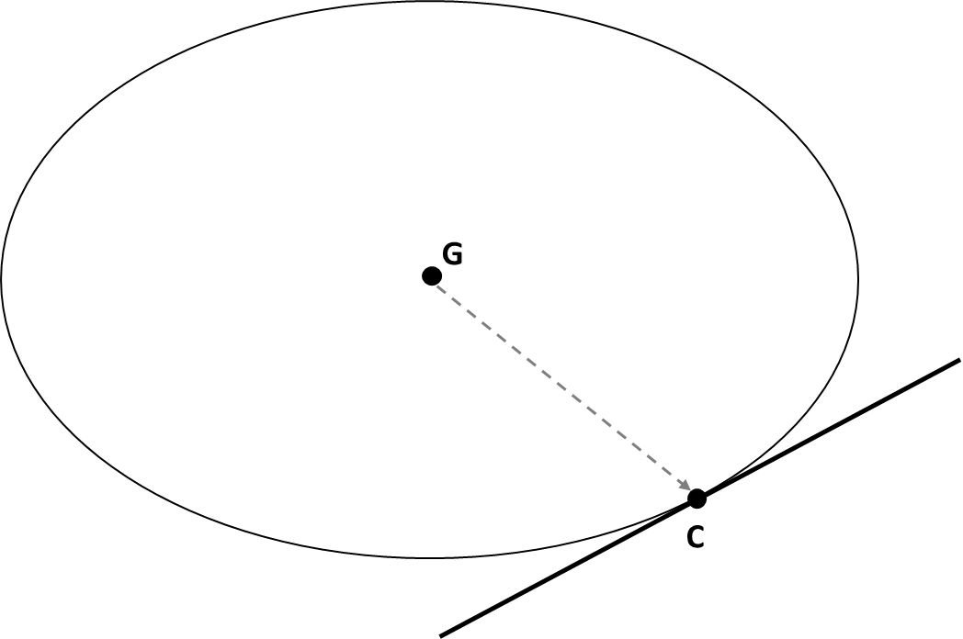
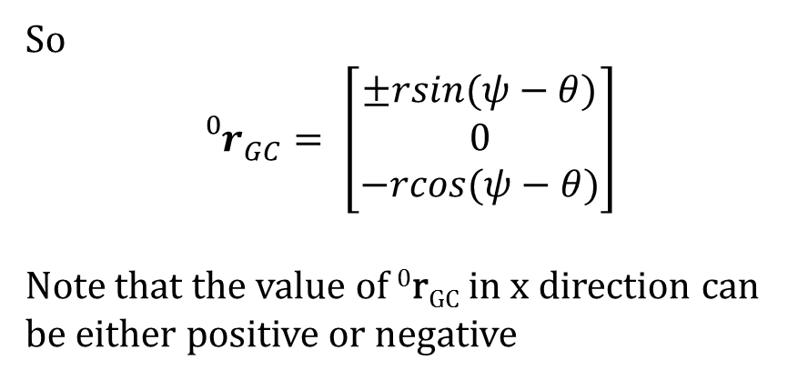
CONSTRAINT EQUATIONS
Constraint equations (from no-slip)
⁰Z
¹Z
So
$${{}_{}^{0}r}_{GC}^{}= \left[\begin{matrix}±rsin(ψ−θ) \\ 0 \\ −rcos(ψ−θ)\end{matrix}\right]$$
Note that the value of ⁰r_{GC} in x direction can be either positive or negative
θ
G (x , z)
⁰X
ψ
r_{GC}
θ
¹X
ψ - θ
O
C
ADVANCE DYNAMIC

Slide 11
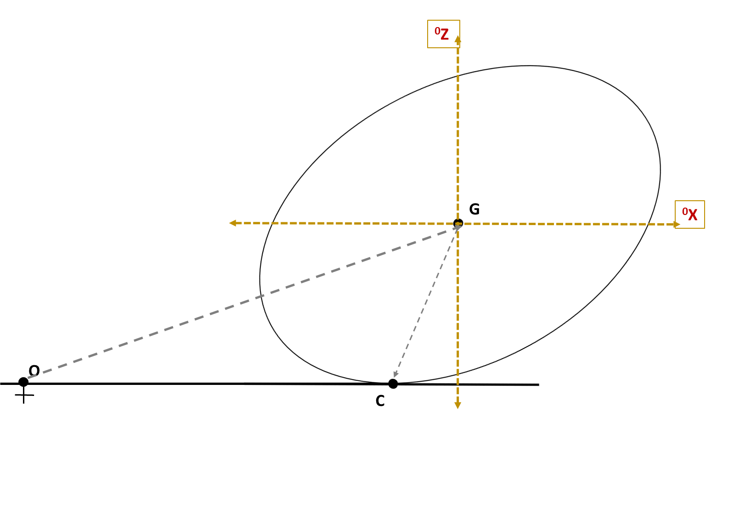
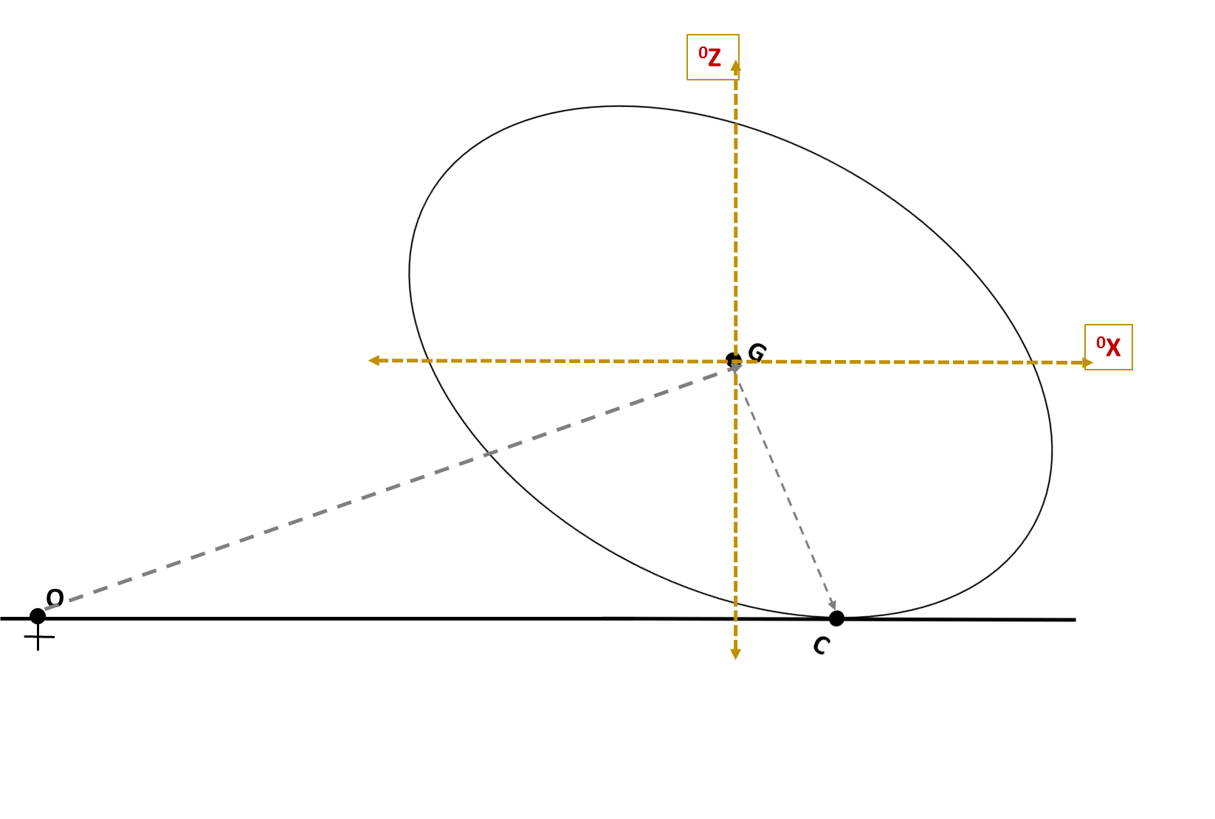
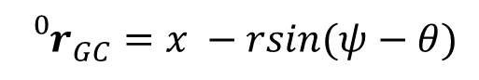

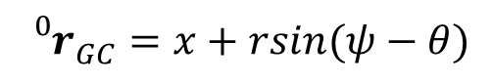
CONSTRAINT EQUATIONS
Two cases of ⁰r_{GC,x} (considering θ from 0 to 2π)
When $\frac{π}{2}≤ θ ≤ π$
Otherwise
$${{}_{}^{0}r}_{GC}^{}=x −rsin(ψ−θ)$$
$${{}_{}^{0}r}_{GC}^{}=x+rsin(ψ−θ)$$
ADVANCE DYNAMIC

Slide 12
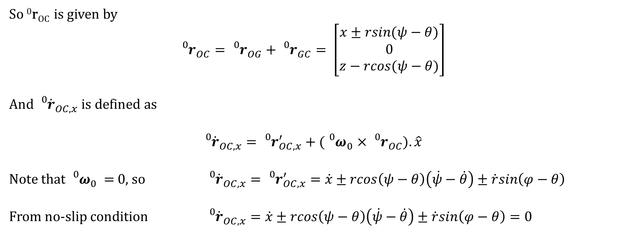
CONSTRAINT EQUATIONS
Constraint equations (from no-slip)
So ⁰r_{OC} is given by
$${{}_{}^{0}r}_{OC}^{}={{}_{}^{0}r}_{OG}^{}+{{}_{}^{0}r}_{GC}^{}= \left[\begin{matrix}x±rsin(ψ−θ) \\ 0 \\ z−rcos(ψ−θ)\end{matrix}\right]$$
And ${{}_{}^{0}{\dot{r}}}_{OC,x}^{}$ is defined as
$${{}_{}^{0}{\dot{r}}}_{OC,x}^{}={{}_{}^{0}r}_{OC,x}^{′}+{({}_{}^{0}ω}_{0}^{}×{{}_{}^{0}r}_{OC}^{}).\hat{x}$$
Note that ${{}_{}^{0}ω}_{0}^{}$ = 0, so ${{}_{}^{0}{\dot{r}}}_{OC,x}^{}={{}_{}^{0}r}_{OC,x}^{′}=\dot{x}±rcos\left(ψ−θ\right)\left(\dot{ψ}−\dot{θ}\right)±\dot{r}sin\left(φ−θ\right)$
From no-slip condition ${{}_{}^{0}{\dot{r}}}_{OC,x}^{}=\dot{x}±rcos\left(ψ−θ\right)\left(\dot{ψ}−\dot{θ}\right)±\dot{r}sin\left(φ−θ\right)=0$
ADVANCE DYNAMIC

Slide 13
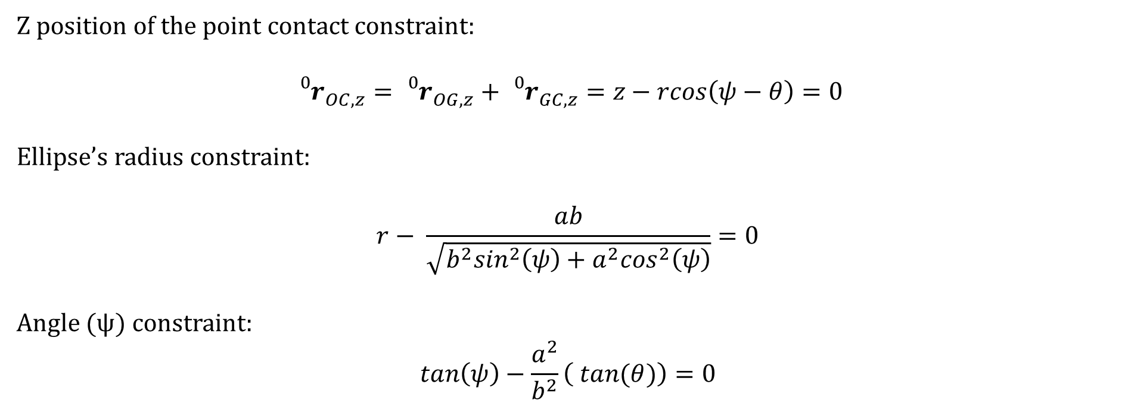
CONSTRAINT EQUATIONS
Other constraints:
Z position of the point contact constraint:
$${{}_{}^{0}r}_{OC,z}^{}={{}_{}^{0}r}_{OG,z}^{}+{{}_{}^{0}r}_{GC,z}^{}=z−rcos\left(ψ−θ\right)=0$$
Ellipse’s radius constraint:
$$r− \frac{ab}{\sqrt{b^{2}\sin^{2}\left(ψ\right)+a^{2}\cos^{2}\left(ψ\right)}}=0$$
Angle (ψ) constraint:
$$tan\left(ψ\right)−\frac{a^{2}}{b^{2}}\left( tan⁡(θ)\right)=0$$
ADVANCE DYNAMIC

Slide 14
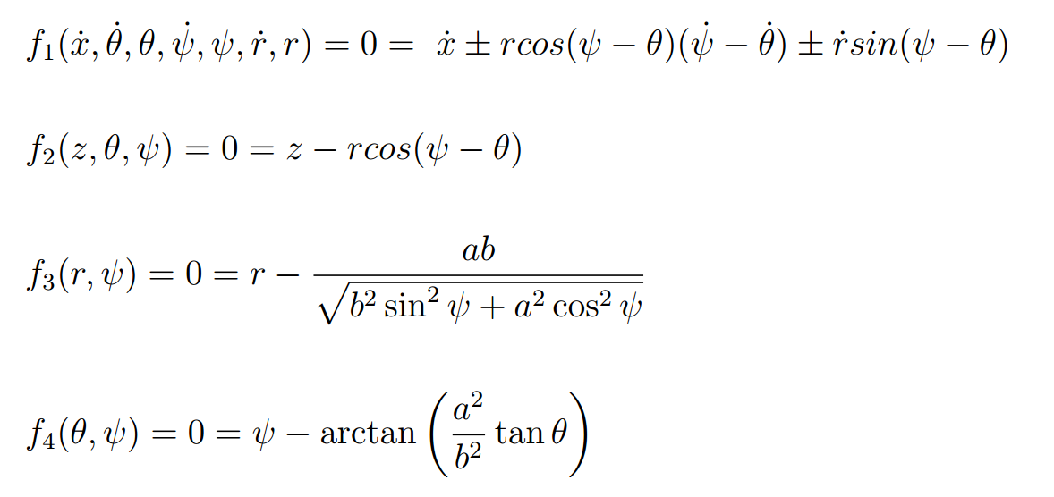
CONSTRAINT EQUATIONS
So we have the following constraint equations:
In which f₁ is a non-holonomic constraint and f₂, f₃, f₄ are holonomic
ADVANCE DYNAMIC

Slide 15
LAGRANGIAN
The Lagrangian:
The ellipse rotates as the contact point traverses along the x axis when an impulse force is applied on it.
As the ellipse moves forward the height of the centre of mass changes simultaneously with it according to the constraint f2.
The ellipse will have kinetic energy from its motion, and potential energy due to gravity only.
ADVANCE DYNAMIC

Slide 16
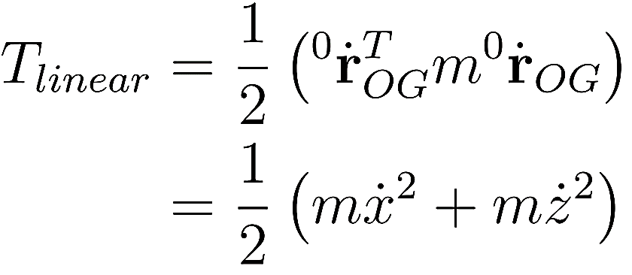
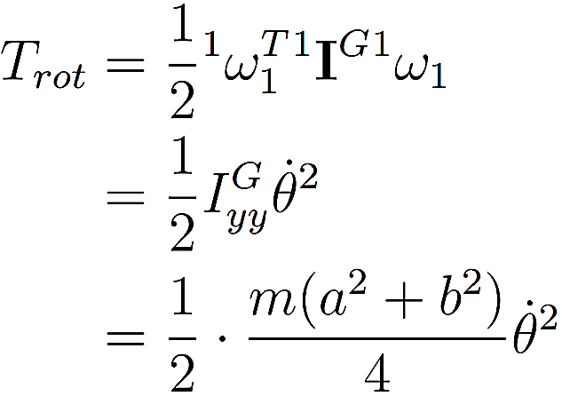
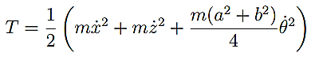
LAGRANGIAN - KINETIC
Kinetic energy
The ellipse will have both rotational as well as linear kinetic energy:
Hence the total K.E. will be:
ADVANCE DYNAMIC

Slide 17
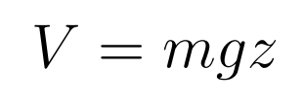
LAGRANGIAN - POTENTIAL
Potential energy
The potential energy is due to the change in height of the centre of mass and is given by:
ADVANCE DYNAMIC

Slide 18
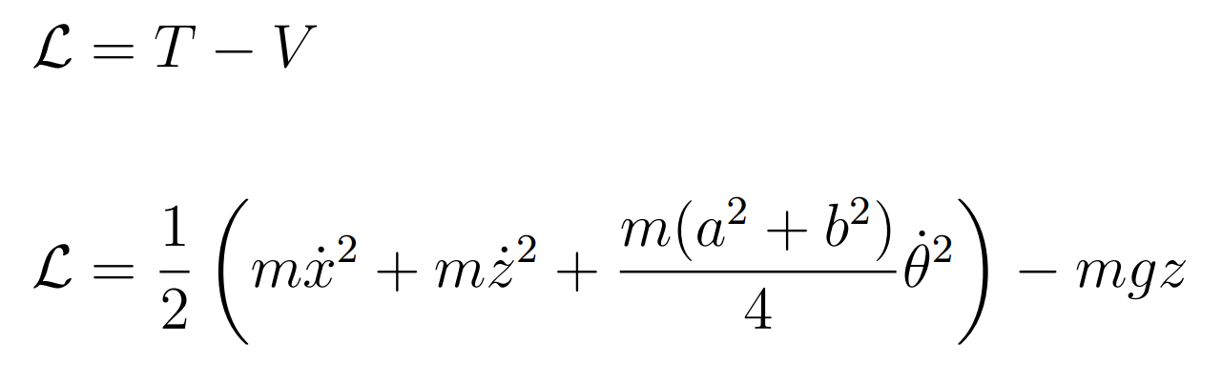
LAGRANGIAN
Lagrangian
Hence, the Lagrangian of the body is given by:
ADVANCE DYNAMIC

Slide 19
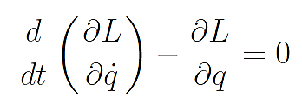
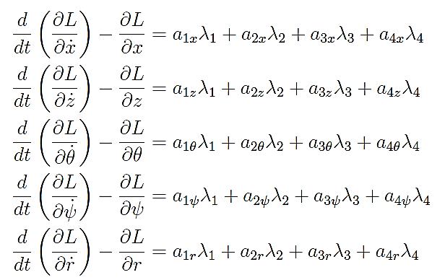
LAGRANGE MULTIPLIER
Lagrange Multipliers
EOM without constraints looks like this:
EOM with constraints looks like this:
ADVANCE DYNAMIC

Slide 20
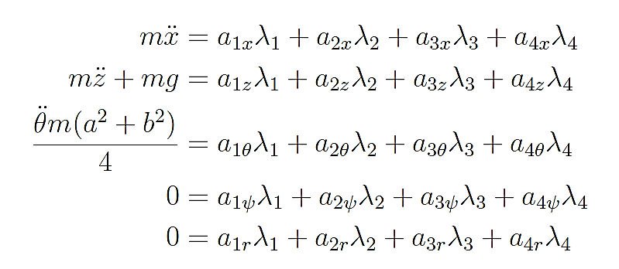
LAGRANGE MULTIPLIER
Equation of Motion in terms of Lagrange multiplier
ADVANCE DYNAMIC

Slide 21
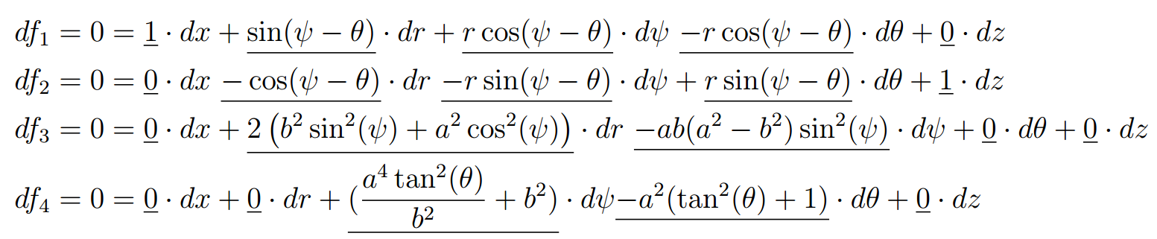
CONSTRAINT EQUATION
PFIFFIAN FORM OF CONSTRAINT EQUATION
ADVANCE DYNAMIC

Slide 22
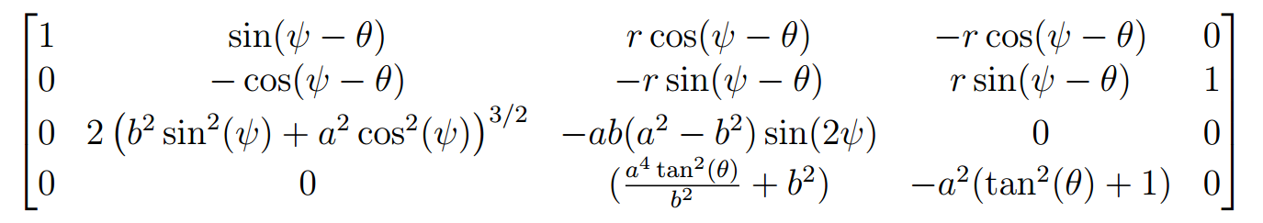
LAGRANGE MULTIPLIER
Coefficient matrix
ADVANCE DYNAMIC

Slide 23
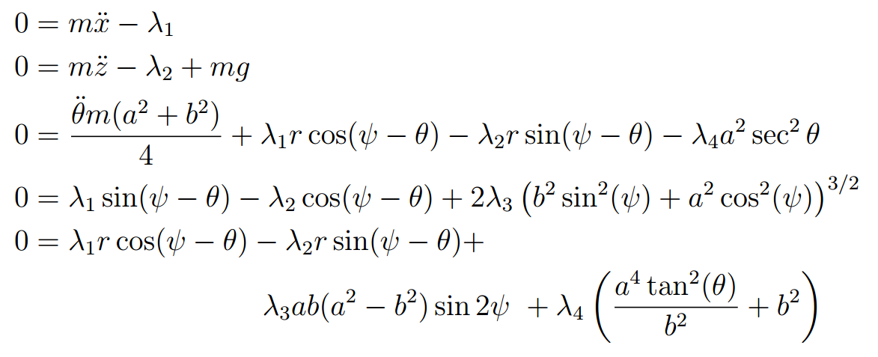
LAGRANGE MULTIPLIER
Substituting Coefficient matrix into EOM
ADVANCE DYNAMIC

Slide 24
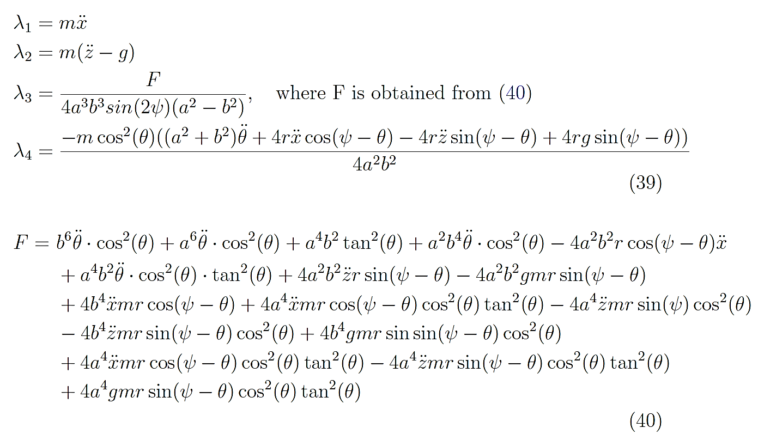
LAGRANGE MULTIPLIER
Values of Lambda
ADVANCE DYNAMIC

Slide 25
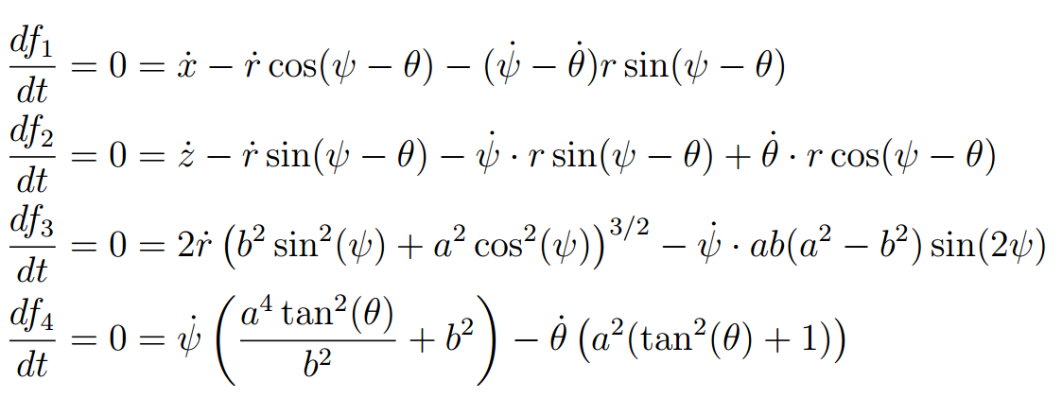
LAGRANGE MULTIPLIER
Velocity form of constraints(additional equations for solving EOM’s)
ADVANCE DYNAMIC

Slide 26
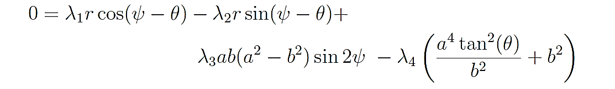
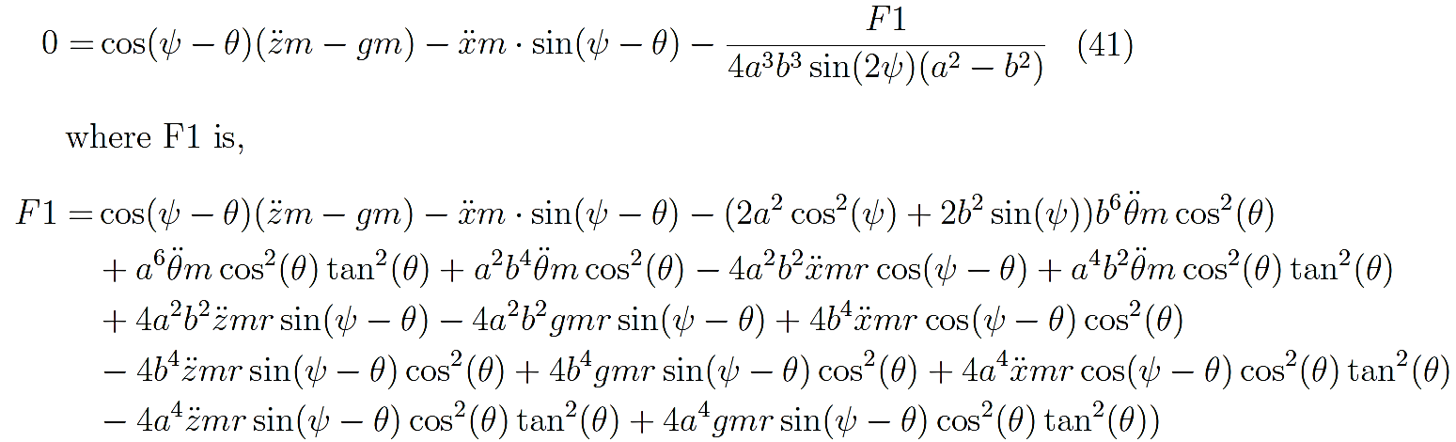
EULER-LAGRANGE EQUATION SOLVE
Values of Lambdas plugged into last EOM
Produces fifth equation as
ADVANCE DYNAMIC

Slide 27
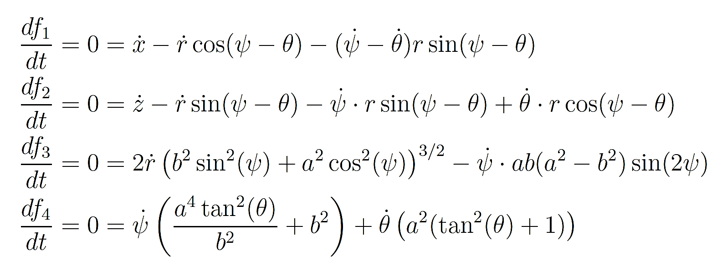
EULER-LAGRANGE EQUATION SOLVE
Four equations of Constraints with produced 5th equation(from EOM) provides 5 eqns
ADVANCE DYNAMIC

Slide 28
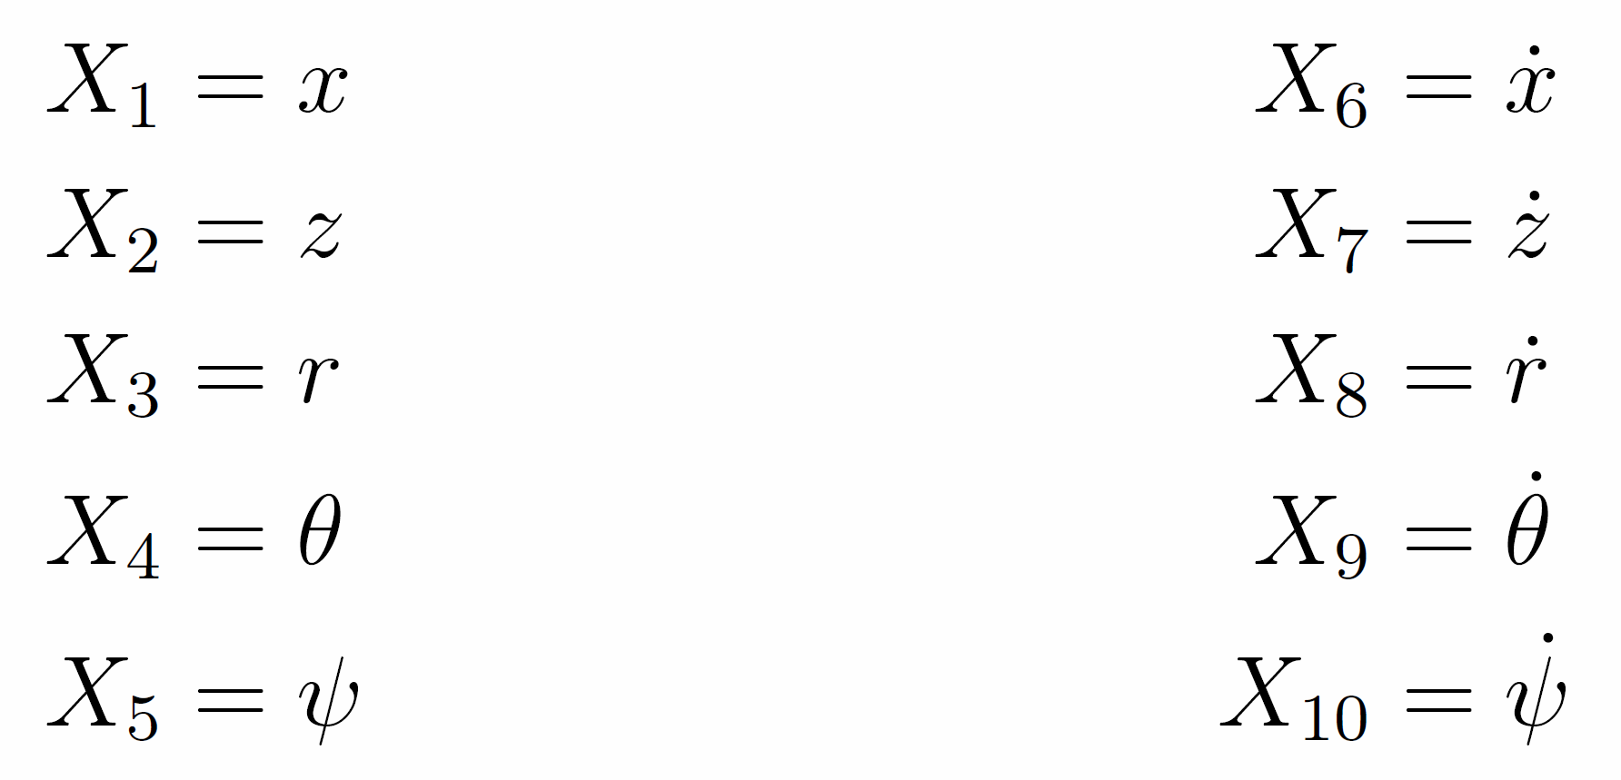
STATE SPACE MODEL
State space
The State space representation of the system can be setup with the following states
ADVANCE DYNAMIC

Slide 29
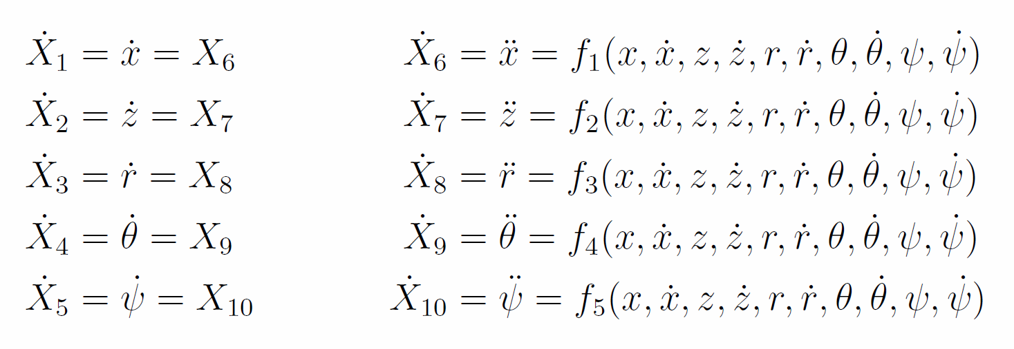
STATE SPACE MODEL
Update Equations
ADVANCE DYNAMIC

Slide 30
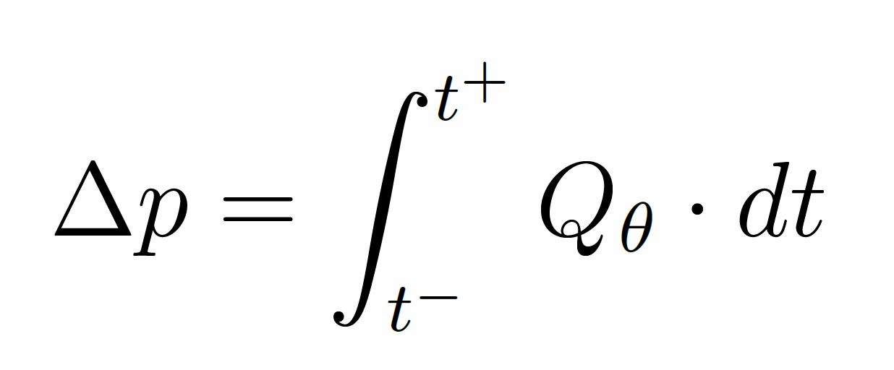
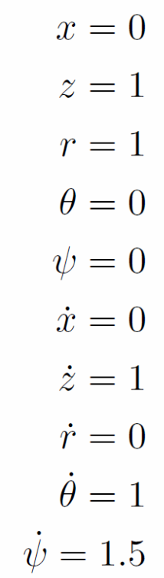
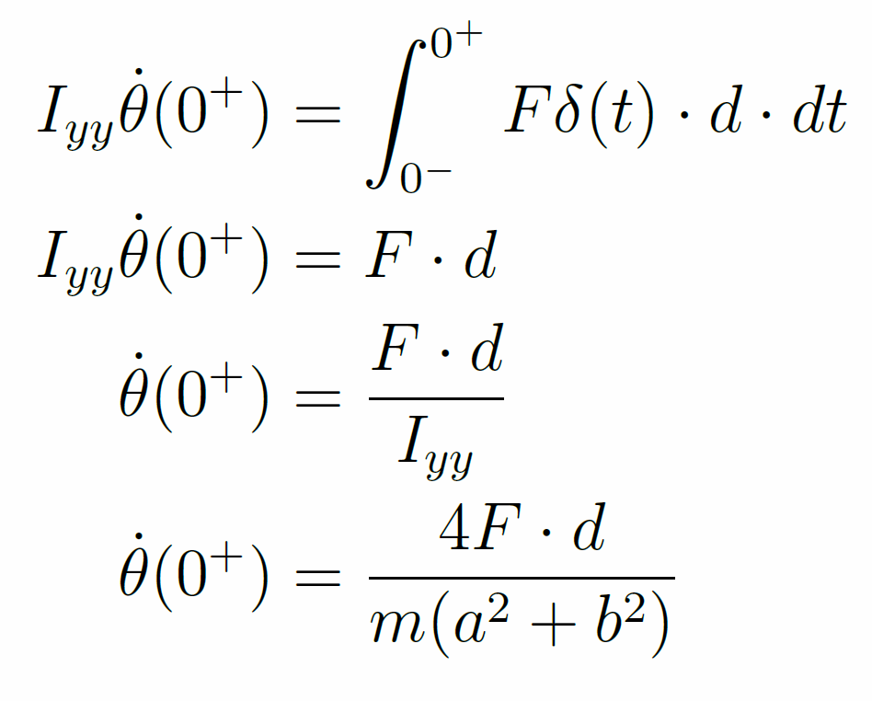
STATE SPACE MODEL
Initial conditions
Initial Theta
Others from constraints
ADVANCE DYNAMIC

Slide 31
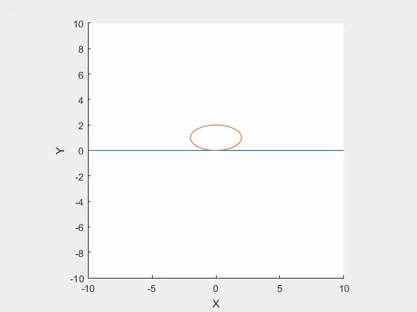
SIMULATION RESULTS
Result from running the simulation
ADVANCE DYNAMIC

Slide 32
SIMULATION RESULTS
What Happened?
Theta is solved correctly
Psi is not solved correctly
R continues to grow
This causes Z to increase, and the ellipse floats upwards
ADVANCE DYNAMIC

Slide 33
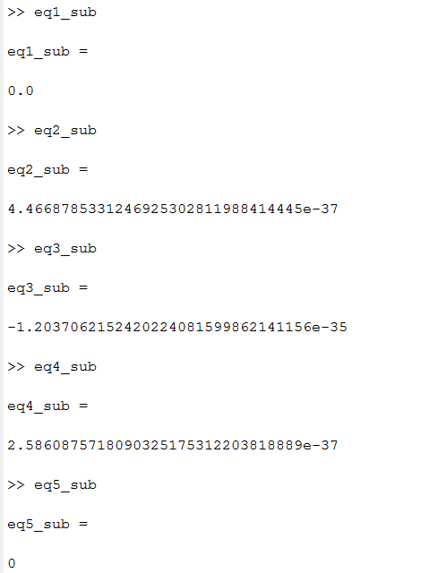
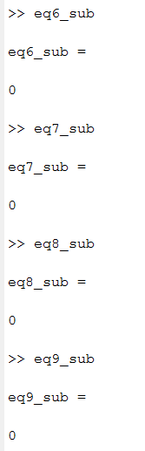
SIMULATION RESULTS
Checking the EoM and EoC using values from the ODE
ADVANCE DYNAMIC

Slide 34
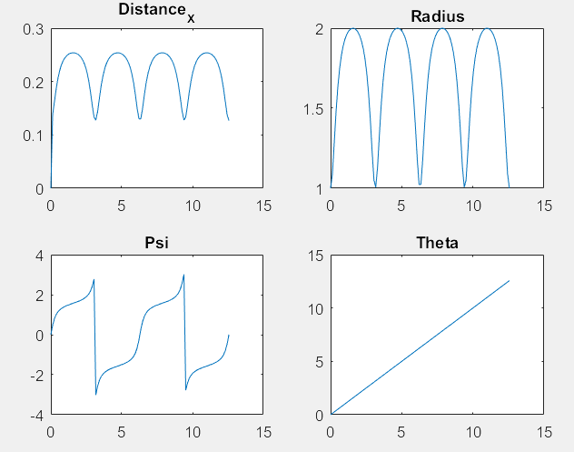
SIMULATION RESULTS
Test the constraints
ADVANCE DYNAMIC

Slide 35
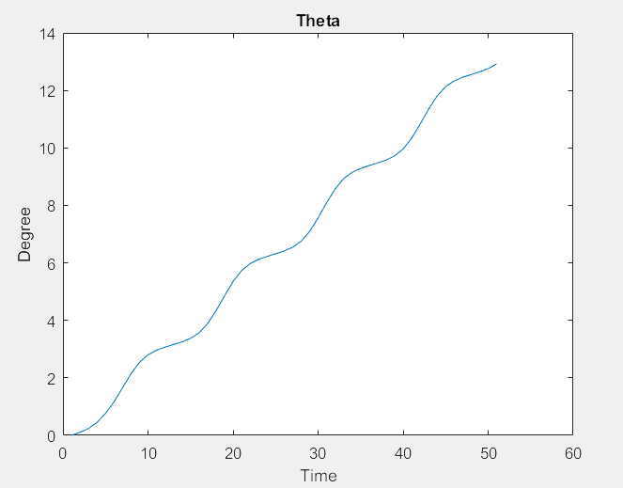
SIMULATION RESULTS
Theta from the simulation is correct
ADVANCE DYNAMIC

Slide 36
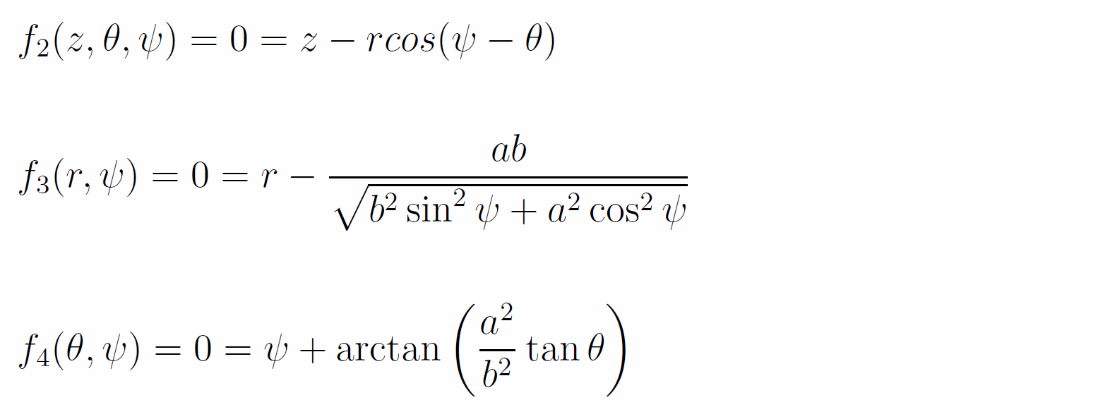
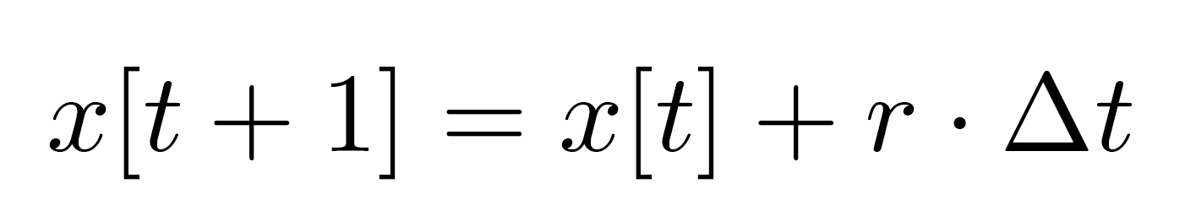
SIMULATION RESULTS
Take theta each time step and compute the configuration from holonomic constraints
ADVANCE DYNAMIC

Slide 37

SIMULATION RESULTS
Results – Theta from Simulation + Constraints
ADVANCE DYNAMIC

Slide 38
THANK YOU FOR YOUR ATTENTION
ADVANCE DYNAMIC

